Slide 1
hashing

Slide 2
In data structure, There are several searching techniques like linear search, binary search, search trees etc.
In these techniques, time taken to search any particular element depends on the total number of elements.
Notes:
Insert a map of your country.

Slide 3
The main drawback of these techniques is-
As the number of elements increases, time taken to perform the search also increases.
This becomes problematic when total number of elements become too large.
Notes:
Insert a map of your country.

Slide 4
Hashing in Data Structure-
Hashing is a well-known technique to search any particular element among several elements.
It minimizes the number of comparisons while performing the search.
Notes:
Insert a map of your country.

Slide 5
advantages
Unlike other searching techniques,
Hashing is extremely efficient.
The time taken by it to perform the search does not depend upon the total number of elements.
Notes:
Insert a map of your country.

Slide 6
Hashing Mechanism
In hashing, An array data structure called as Hash table is used to store the data items.
Based on the hash key value, data items are inserted into the hash table.
Notes:
Insert a map of your country.

Slide 7
Hash Key Value
Hash key value is a special value that serves as an index for a data item.
It indicates where the data item should be be stored in the hash table.
Hash key value is generated using a hash function.
Notes:
Insert a map of your country.

Slide 8
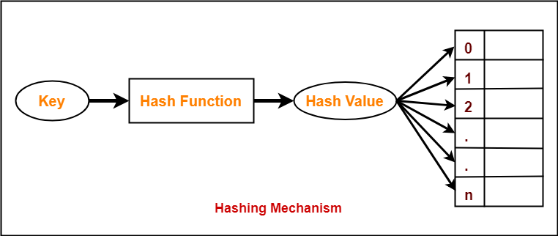
Notes:
Insert a map of your country.

Slide 9
Hash function
Hash function takes the data item as an input and returns a small integer value as an output.
The small integer value is called as a hash value.
Hash value of the data item is then used as an index for storing it into the hash table.
Key MOD N
Notes:
Insert a map of your country.

Slide 10
Properties of Hash Function-
It is efficiently computable.
It minimizes the number of collisions.
It distributes the keys uniformly over the table
Notes:
Insert a map of your country.

Slide 11
in Hashing technique, the hash table and hash function are used.
Using the hash function, we can calculate the address at which the value can be stored.
The main idea behind the hashing is to create the (key/value) pairs.
Notes:
Insert a map of your country.

Slide 12
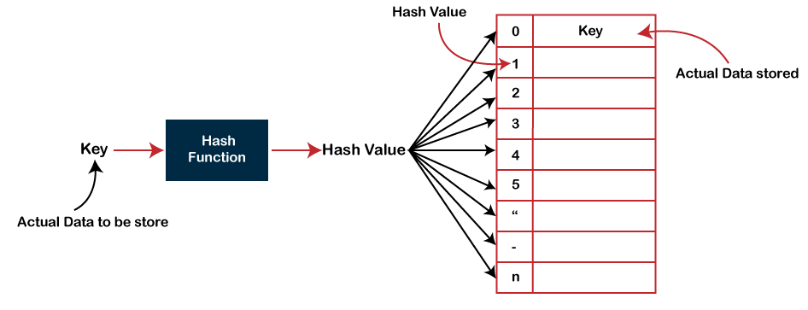
If the key is given, then the algorithm computes the index at which the value would be stored. It can be written as:
Index = hash(key)
Notes:
Insert a map of your country.

Slide 13
There are three ways of calculating the hash function:
Division method
Folding method
Mid square method
Notes:
Insert a map of your country.

Slide 14
division method,
In the division method, the hash function can be defined as:
h(k_{i}) = k_{i} % m;
where m is the size of the hash table.
For example, if the key value is 6 and the size of the hash table is 10. When we apply the hash function to key 6 then the index would be:
h(6) = 6%10 = 6
The index is 6 at which the value is stored.
Notes:
Insert a map of your country.

Slide 15
50 , 700 , 76 , 73 , 16

Slide 16
Collision
Hash function is used to compute the hash value for a key.
Hash value is then used as an index to store the key in the hash table.
Hash function may return the same hash value for two or more keys.
When the hash value of a key maps to an already occupied bucket of the hash table,
it is called as a Collision.
Notes:
Insert a map of your country.

Slide 17
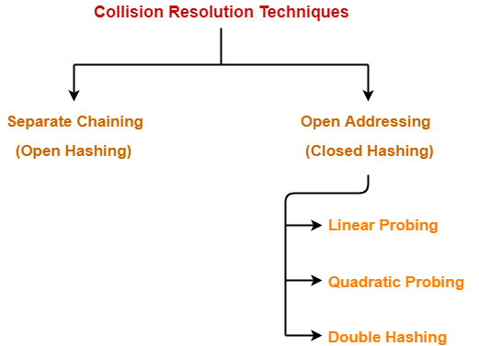
Collision Resolution Techniques
Collision Resolution Techniques are the techniques used for resolving or handling the collision.
Notes:
Insert a map of your country.

Slide 18
Separate Chaining
To handle the collision,
This technique creates a linked list to the slot for which collision occurs.
The new key is then inserted in the linked list.
These linked lists to the slots appear like chains.
That is why, this technique is called as separate chaining.
Notes:
Insert a map of your country.

Slide 19
Using the hash function ‘key mod 7’, insert the following sequence of keys in the hash table-
50, 700, 76, 85, 92, 73 and 101
Use separate chaining technique for collision resolution.
Notes:
Insert a map of your country.

Slide 20
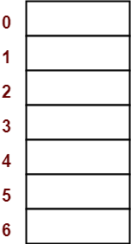
Step-01:
Draw an empty hash table.
For the given hash function, the possible range of hash values is [0, 6].
So, draw an empty hash table consisting of 7 buckets as-
Notes:
Insert a map of your country.

Slide 21
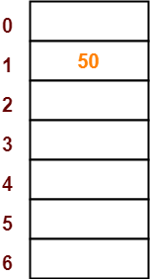
Step-02:
Insert the given keys in the hash table one by one.
The first key to be inserted in the hash table = 50.
Bucket of the hash table to which key 50 maps = 50 mod 7 = 1.
So, key 50 will be inserted in bucket-1 of the hash table as-
Notes:
Insert a map of your country.

Slide 22
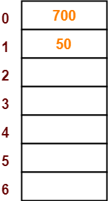
Step-03:
The next key to be inserted in the hash table = 700.
Bucket of the hash table to which key 700 maps = 700 mod 7 = 0.
So, key 700 will be inserted in bucket-0 of the hash table as-
Notes:
Insert a map of your country.

Slide 23
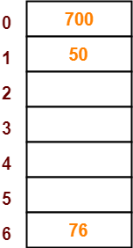
Step-04:
The next key to be inserted in the hash table = 76.
Bucket of the hash table to which key 76 maps = 76 mod 7 = 6.
So, key 76 will be inserted in bucket-6 of the hash table as-
Notes:
Insert a map of your country.

Slide 24
Step-05:
The next key to be inserted in the hash table = 85.
Bucket of the hash table to which key 85 maps = 85 mod 7 = 1.
Since bucket-1 is already occupied, so collision occurs.
Separate chaining handles the collision by creating a linked list to bucket-1.
Notes:
Insert a map of your country.

Slide 25
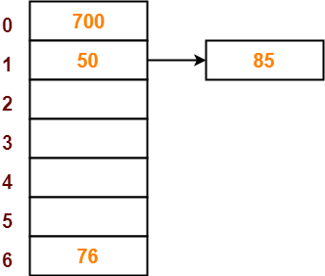
So, key 85 will be inserted in bucket-1 of the hash table as-
Notes:
Insert a map of your country.

Slide 26
Step 6
The next key to be inserted in the hash table = 92.
Bucket of the hash table to which key 92 maps = 92 mod 7 = 1.
Since bucket-1 is already occupied, so collision occurs.
Separate chaining handles the collision by creating a linked list to bucket-1
Notes:
Insert a map of your country.

Slide 27
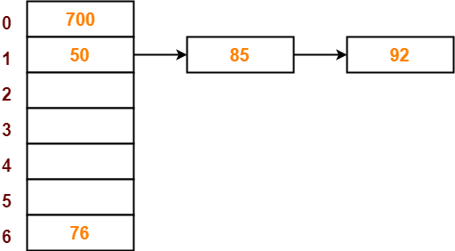
So, key 92 will be inserted in bucket-1 of the hash table as-
Notes:
Insert a map of your country.

Slide 28

Step-07:
The next key to be inserted in the hash table = 73.
Bucket of the hash table to which key 73 maps = 73 mod 7 = 3.
So, key 73 will be inserted in bucket-3 of the hash table as-
Notes:
Insert a map of your country.

Slide 29
Step-08:
The next key to be inserted in the hash table = 101.
Bucket of the hash table to which key 101 maps = 101 mod 7 = 3.
Since bucket-3 is already occupied, so collision occurs.
Separate chaining handles the collision by creating a linked list to bucket-3.
Notes:
Insert a map of your country.

Slide 30
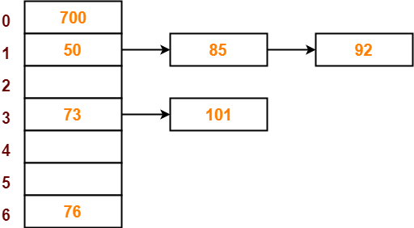
So, key 101 will be inserted in bucket-3 of the hash table as-
Notes:
Insert a map of your country.

Slide 31
Separate Chaining: Disadvantages
Parts of the array might never be used.
As chains get longer, search time increases to O(n) in the worst case.
Constructing new chain nodes is relatively expensive (still constant time, but the constant is high).
Is there a way to use the “unused” space in the array instead of using chains to make more space?

Slide 32
Open addressing
Like separate chaining, open addressing is a method for handling collisions.
in Open Addressing, all elements are stored in the hash table itself.
So at any point, the size of the table must be greater than or equal to the total number of keys
Notes:
Insert a map of your country.

Slide 33
Techniques used for open addressing are-
Linear Probing
Quadratic Probing
Double Hashing
Notes:
Insert a map of your country.

Slide 34
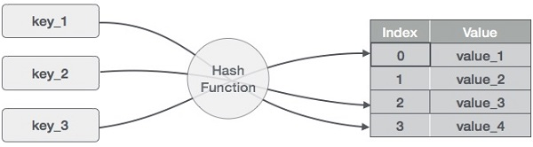
Consider an example of hash table of size 20, and the following items are to be stored. Item are in the (key,value) format.
Notes:
Insert a map of your country.

Slide 35
Linear Probing
As we can see, it may happen that the hashing technique is used to create an already used index of the array.
In such a case, we can search the next empty location in the array by looking into the next cell until we find an empty cell.
This technique is called linear probing.
Notes:
Insert a map of your country.

Slide 36
56 79 41 44 21 43 11 29
H(k’) = h(k)+1 mod m

Slide 37
Sr.No. | Key | Hash | Array Index | After Linear Probing, Array Index
1 | 1 | 1 % 20 = 1 | 1 | 1
2 | 2 | 2 % 20 = 2 | 2 | 2
3 | 42 | 42 % 20 = 2 | 2 | 3
4 | 4 | 4 % 20 = 4 | 4 | 4
5 | 12 | 12 % 20 = 12 | 12 | 12
6 | 14 | 14 % 20 = 14 | 14 | 14
7 | 17 | 17 % 20 = 17 | 17 | 17
8 | 13 | 13 % 20 = 13 | 13 | 13
9 | 37 | 37 % 20 = 17 | 17 | 18
Notes:
Insert a map of your country.

Slide 38
Drawback of linear probing
In some situations Searching operation takes more time .
Primary clustering
After performing deletion operation , in some cases item is present in memory but we unable to fetch (we printed item not found)
Insertion also takes more time if collision occurs .

Slide 39
Deletion resolve
Symbol
Shifting (many manipulation)
After deletion hash table again same elemnts filled()

Slide 40
Quadratic Probing
In quadratic probing,
When collision occurs, we probe for i²‘th bucket in i^{th} iteration.
We keep probing until an empty bucket is found.
Notes:
Insert a map of your country.

Slide 41
89 18 49 58 69 29 where m=10

Slide 42
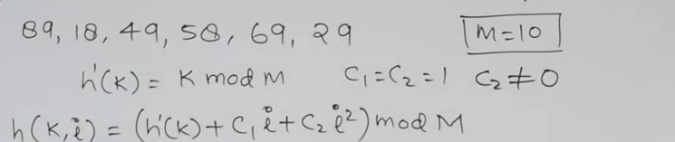
89 18 49 58 69 29

Slide 43
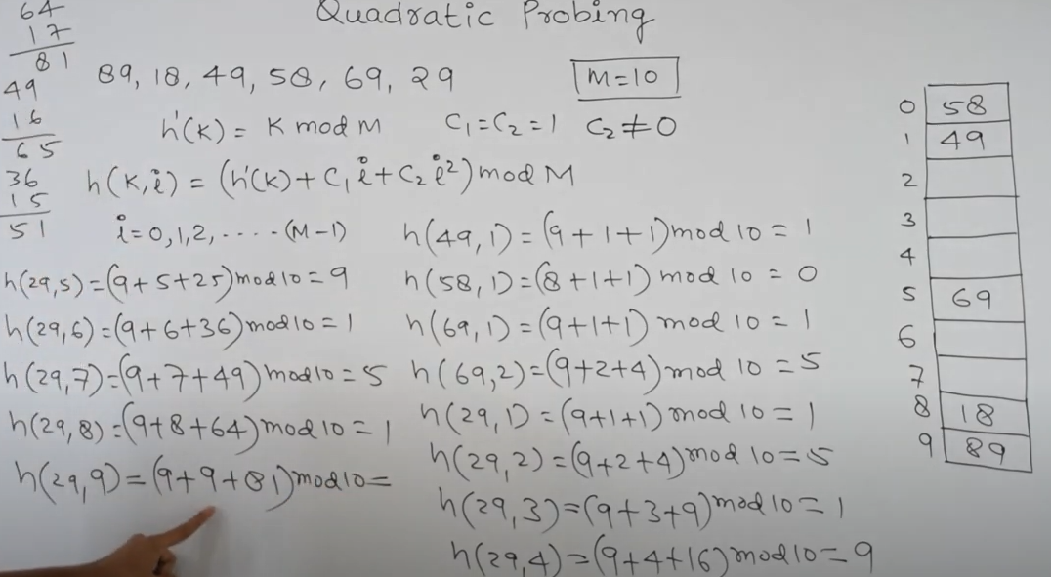

Slide 44
Drawback of quadratic probing
Space is avable but we unable to store element

Slide 45
Double Hashing
In double hashing, We use another hash function hash2(x) and look for i * hash2(x) bucket in i^{th} iteration.
It requires more computation time as two hash functions need to be computed.
Notes:
Insert a map of your country.

Slide 46
conclusion
Linear Probing has the best cache performance but suffers from clustering.
Quadratic probing lies between the two in terms of cache performance and clustering.
Double caching has poor cache performance but no clustering.
https://www.youtube.com/watch?v=mFY0J5W8Udk
Notes:
Insert a map of your country.

Slide 47
Linear probing
H(k)=k mod 10
H(k,i)=(h(k)+i) mod 10
Keys = 43 135 72 23 99 19 82 ,22
Advantage : no extra space
DisAdavatges : primary clustering
Probe ????

Slide 48
QUADRATIC PROBING :
H(k)=k mod 10
H(k,i)=(h(k)+i2) mod 10
Keys = 42 16 11 13 18 27 36 62
Advantage : no extra space
primary clustering resolved
DisAdvantages :no guarantee of finding slot

Slide 49
The keys 1 , 3 ,12 , 4, 25 ,6 , 16 , 20 ,8 are inserted into empty hash table of length 10 using open addressing with hash function h(i) =i2 mod 10 and linear probing . What is the resultant hash table and find maximum probe .

Slide 50
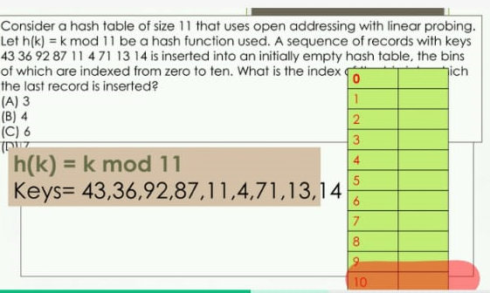

Slide 51
Double Hashing
Given hash function
H1(k)= k mod 11
H2(k) = 8-(K mod 8)
H1(k)+ i* H2(k) mod 11
Keys : 20 34 45 70 56
ADVANTAGES : Guaretee for free slot (all slots occupied )
Uniformly distribute becuz of 2 hash functions .
Clustering resolved
Dis : O(n)

Slide 52
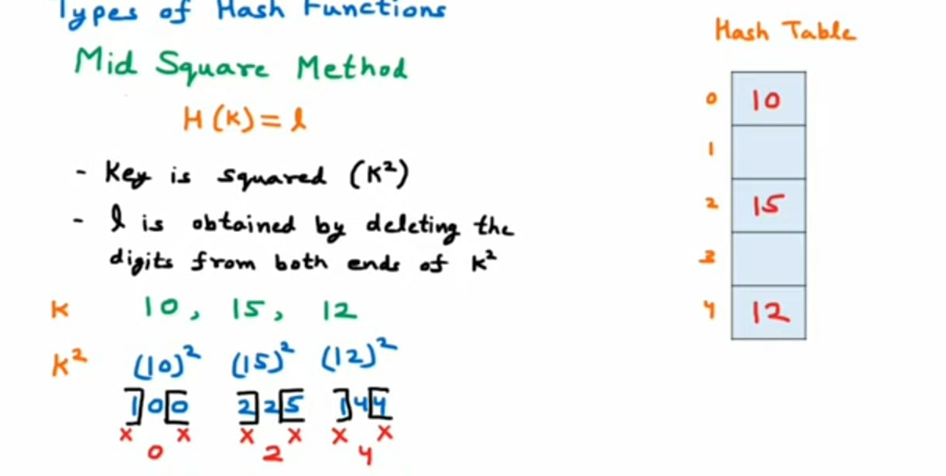
MID SQUAE METHOD

Slide 53
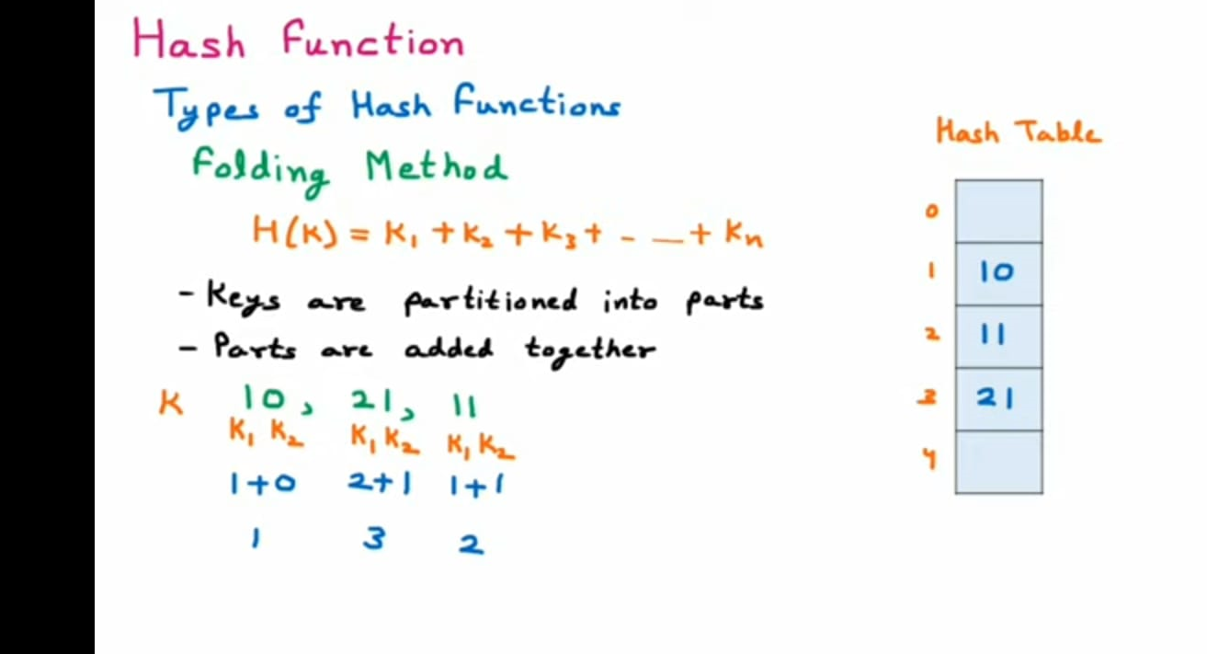
FOLDING METHOD

Slide 54
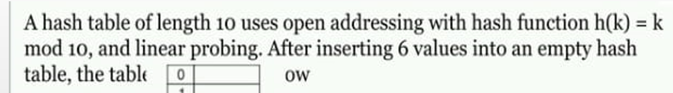
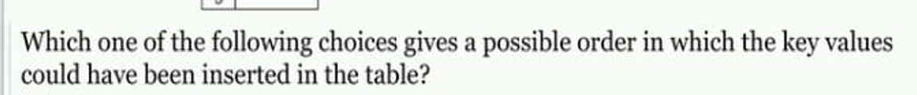

Slide 55
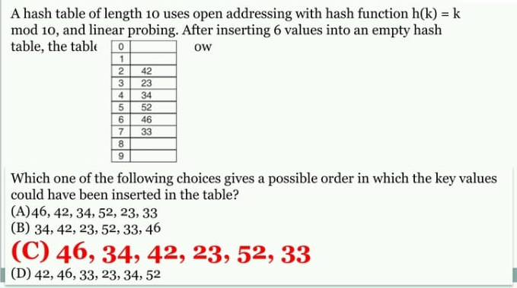

Slide 56
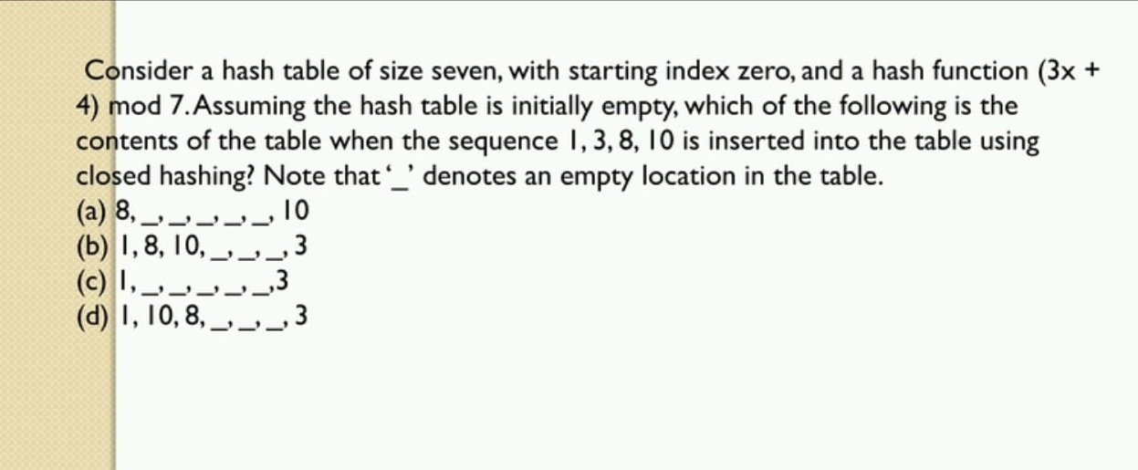

Slide 57
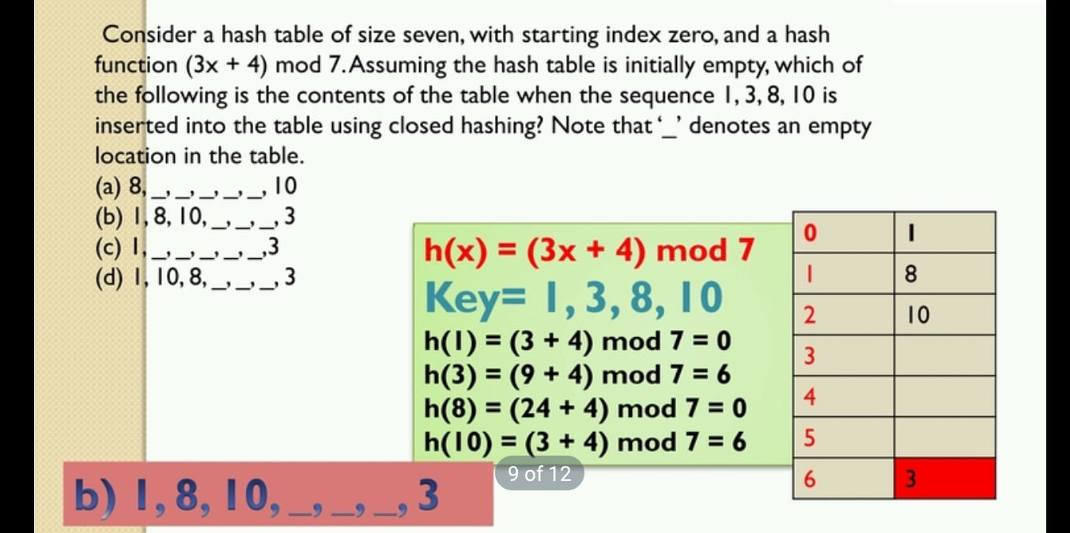

Slide 58
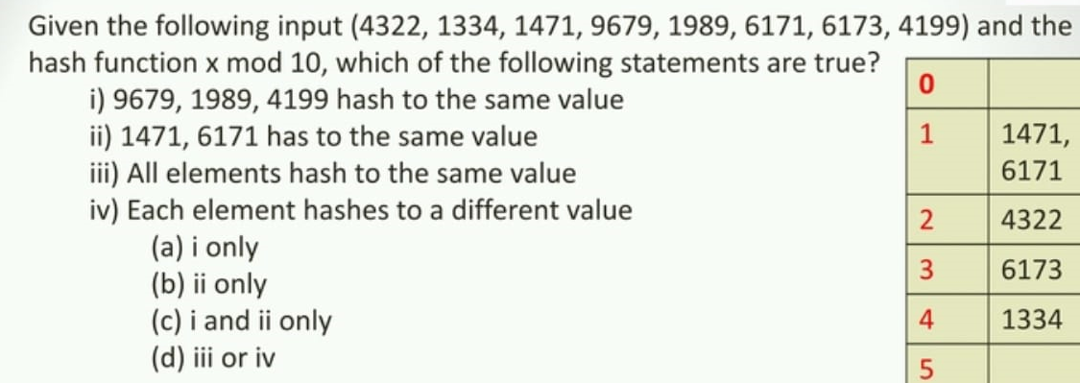

Slide 59
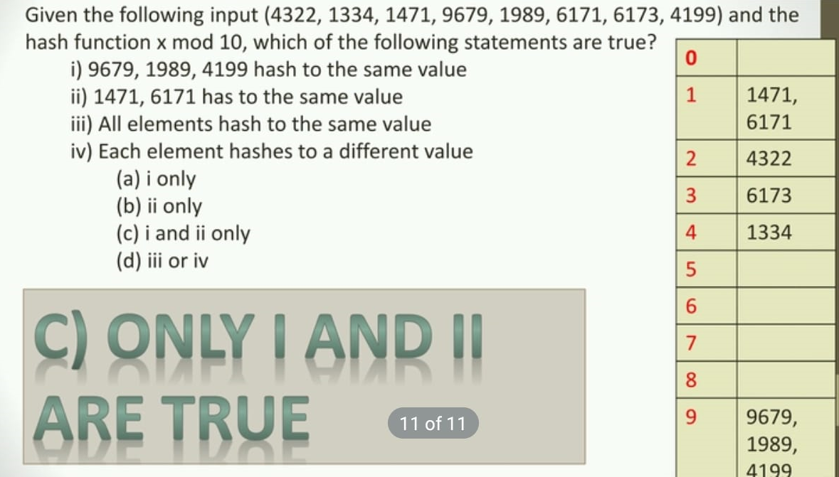

Slide 60
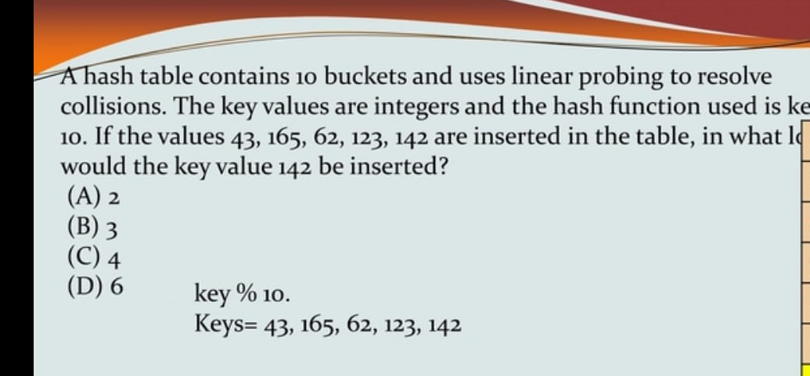

Slide 61
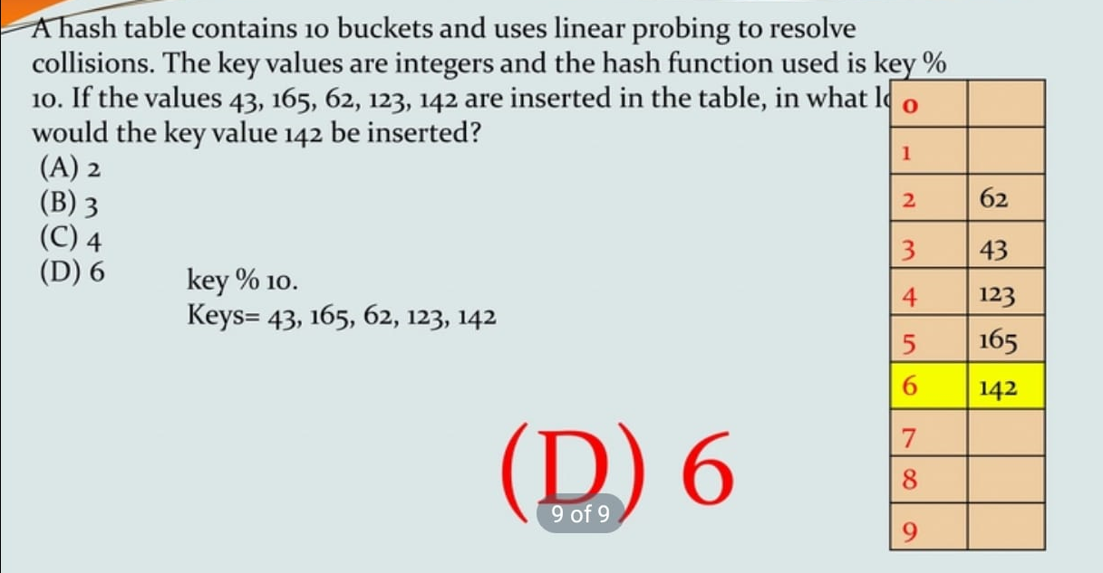

Slide 62
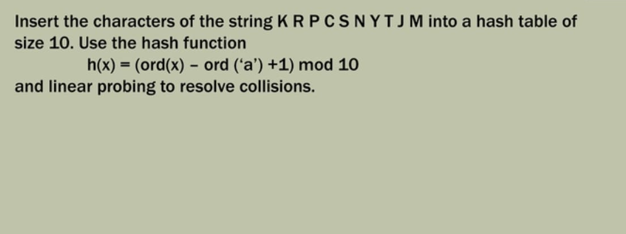

Slide 63
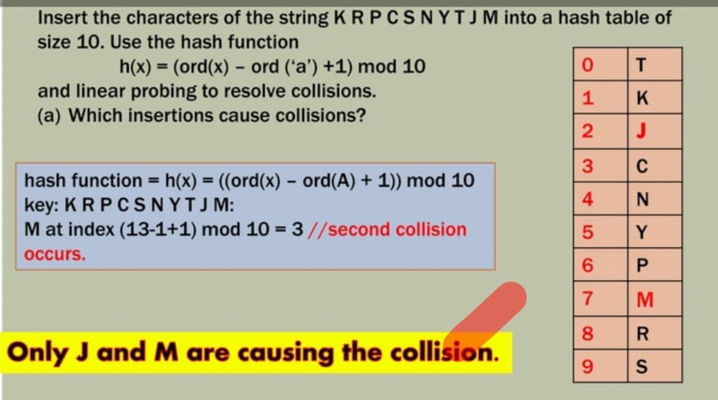

Slide 64
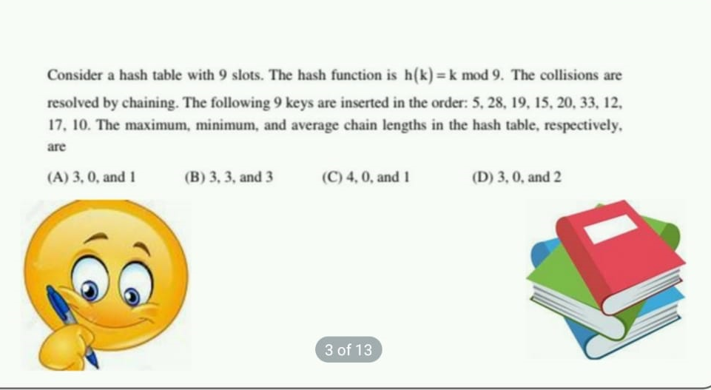

Slide 65
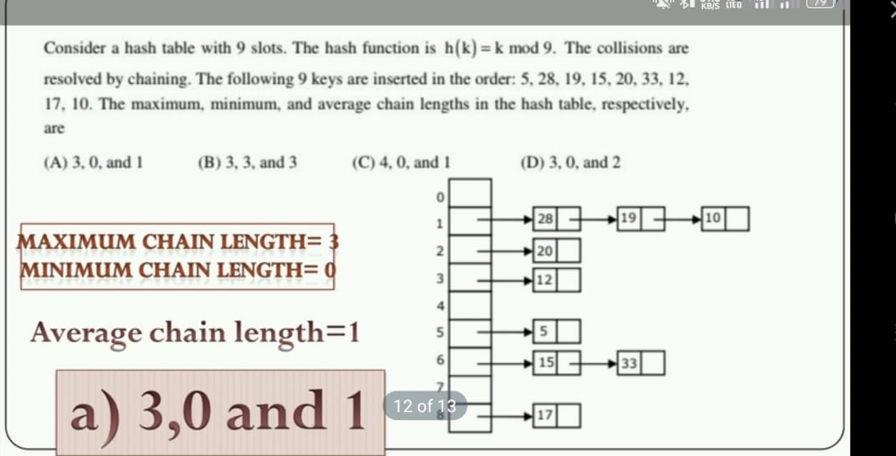

Slide 66
REHASHING
JAVATPOINT

Slide 67
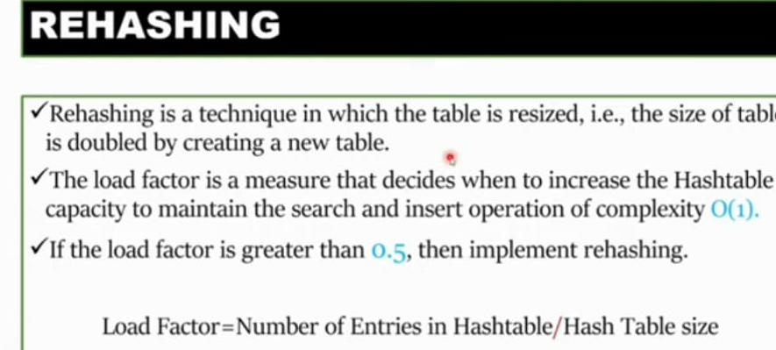

Slide 68
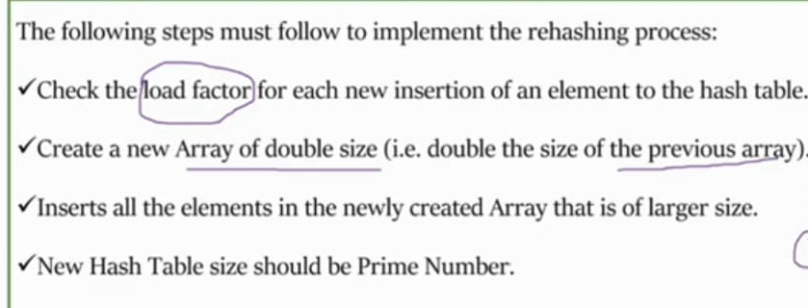

Slide 69
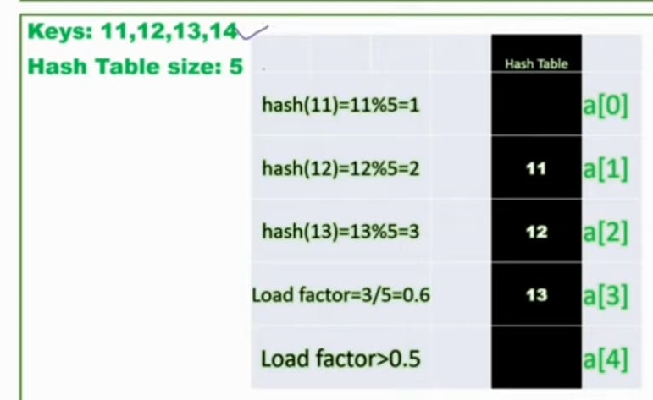

Slide 70
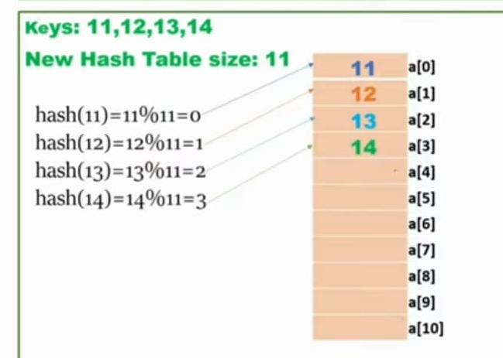
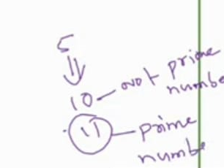

Slide 71
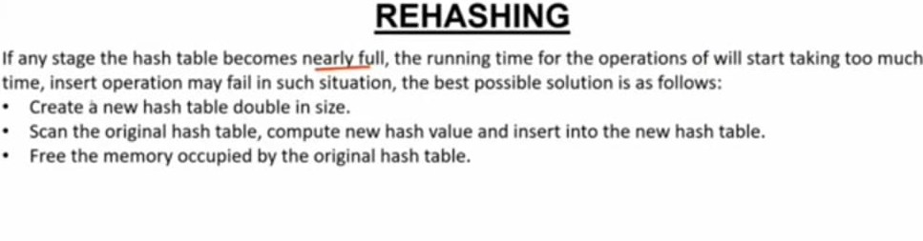

Slide 72


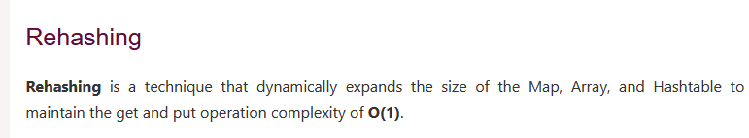

Slide 73
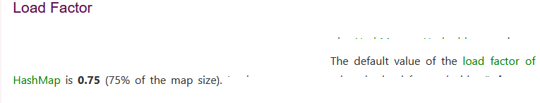
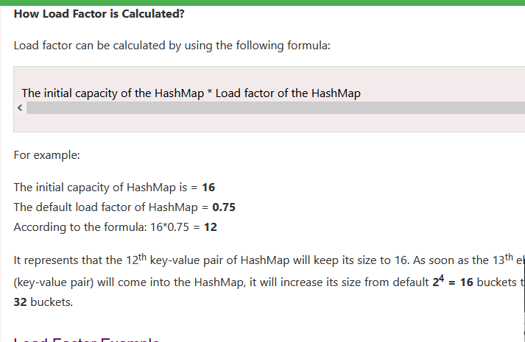

Slide 74
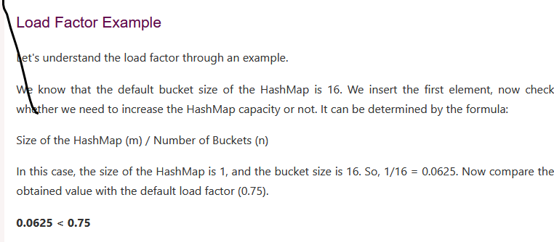

Slide 75
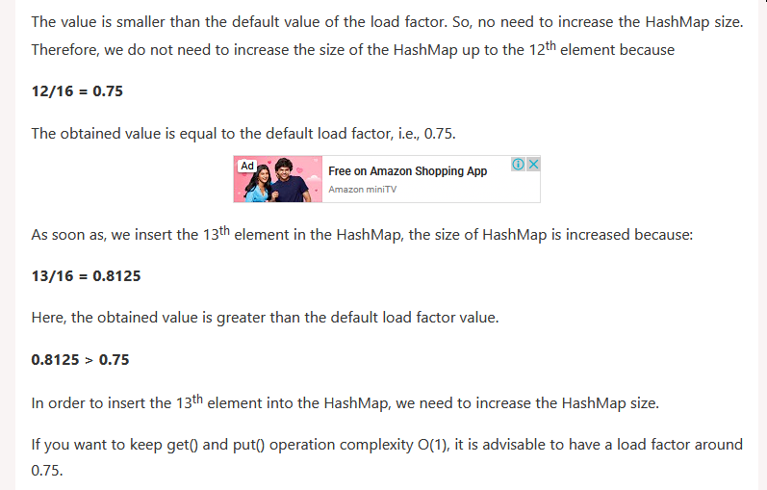

Slide 76
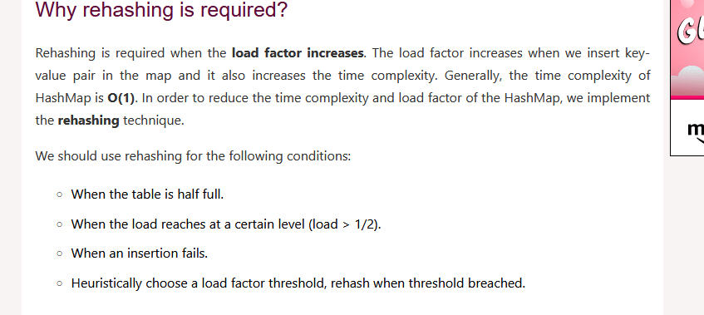

Slide 77
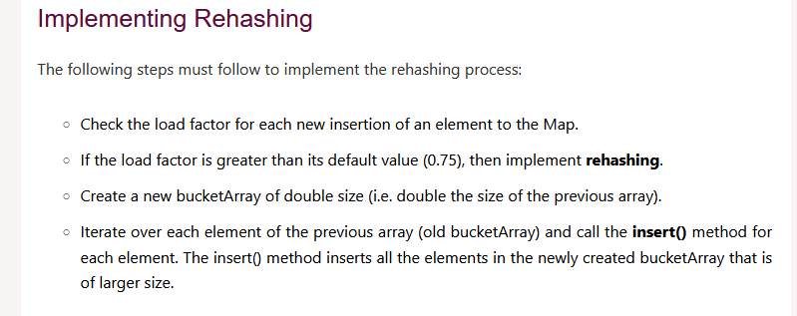

Slide 78
